Slide 1



Maine PCMH/HH and BHH
Learning Collaboratives
SIM Steering Committee
January 27, 2016
Lisa Letourneau, MD, MPH, Executive Director
Liz Miller, MPH, Project Manager
Ashley Soule, MPH, LMSW-CC, Project Manager
Lisa Tuttle, MPH, Program Director

Slide 2

Purpose of Learning Collaboratives
Educational and technical support support to PCMH/HH practices and BHH organizations
Focus on transformation using 10 Core Expectations, outcome of reducing readmissions, and continuous quality improvement
Provide opportunities for peer-to-peer and interdisciplinary learning and collaboration to achieve and maintain true person-centered, team-based care
Notes:
If BHHO teams receive QI support through the BHH Learning Collaborative, they will be successful in fulling the 10 BHH Core Expectations, resulting in improvements in integrated care, improved physical and behavioral health outcomes, increased communication between health care providers, greater use of preventive services, community supports, and self-management tools for adults with Serious Mental Illness and children with Serious Emotional Disturbance.
Primary care practices participating in the MaineCare Health Homes (HH) initiative and the HH Learning Collaborative will successfully implement the PCMH/HH 10 Core Expectations and HH required screenings, resulting in improvements in clinical quality, integrated care, and patient experience, and decreasing avoidable health care spending for individuals with chronic conditions.

Slide 3
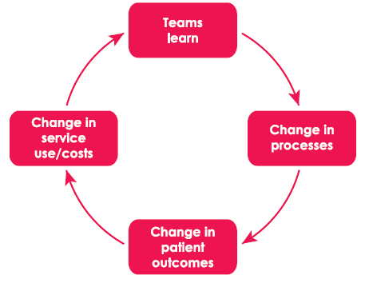
Learning Collaboratives: Initial Focus on Key Process Changes
Notes:
Graphic from recent evidence review: The Health Foundation Improvement collaboratives in health care Evidence Scan July 2014
More empirical evidence about impact on direct changes to professional behavior and care processes than on impacts in the quality of care for service users or health service outcomes
Research limitations, simultaneous interventions, broader environmental factors, lack of comparative studies

Slide 4
PCMH/HH Learning Collaborative
Maine Quality Counts Patient Centered Medical Home Initiative
2009: Pilot began with 26 practices
December 2015: 170+ participating primary care practices across the state
Goals:
Improve care
Reduce overall health care costs
Through supporting practice teams in providing team-based, patient centered care

Slide 5
BHH Learning Collaborative
Launched BHHs Learning Collaborative (Apr 2014) with 26 total BHHOs
Currently supporting 29 BHHOs at 65+ sites, in 3 cohorts
Goals:
Improve integrated care
Increase communication between health care providers,
greater use of preventive services, community supports, and self-management tools for adults with Serious Mental Illness and children with Serious Emotional Disturbance.
By providing Quality Improvement support to BHHOs

Slide 6
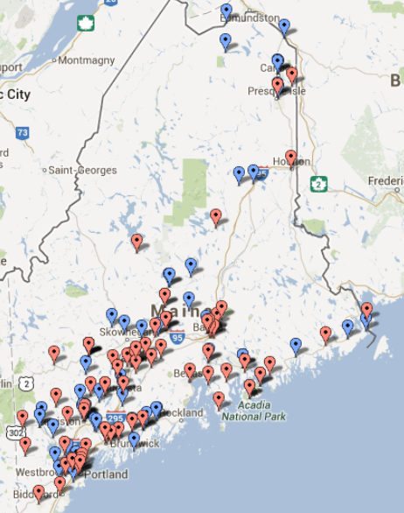
PCMH/HH and BHH Learning Collaboratives
Monthly Webinars
Learning Sessions: 3x/yr
Regional Forums (Primary Care & Medical Neighborhood): 2x/yr
Monthly e-Newsletters
Online resources and tools
On-site Quality Improvement Support

Slide 7

Webinars
Monthly
Responds to evaluation findings by maximizing practice peer sharing, best practices
Features guest speakers/content experts
“On the ground” practice/organization sharing of best practices, promising strategies
Opportunity for Q & A, peer to peer learning
Presentation and audio recordings online
Podcast of webinar available 48 hours following live webinar

Slide 8
Learning Sessions
Occur 3 times per year
All-day learning event
Keynote presentations
Breakout sessions
Networking opportunities
Peer-Peer learning opportunities
Can bring up to 5 team members and 2+ patient partners/consumers
Evaluation required in order to receive CME

Slide 9
PCMH/HH Learning Collaborative
Regional Forums
Held in 6 locations across state:
Presque Isle, Orono, Machias Lewiston, Augusta, Portland
- Focus on improving care transitions in the medical neighborhood
Content expert, typically from each region, presents and partakes in small group discussions, change idea activities
Brings together practices, patient partners, and their medical neighborhood partners

Slide 10
Evaluation and Feedback
Learning
Session
Learning Collaborative Content Planning
Evaluation
Webinar
Practice Self Reports
Webinar
Webinar
Webinar
Evaluation
Evaluation
Quality Improvement Support
Evaluation
Regional Forums
Webinar
Webinar
Webinar
Webinar
Evaluation
Evaluation
Evaluation
Learning
Session
Regional Forums
Learning
Session
Webinar
Webinar
Webinar
Webinar
Evaluation
Notes:
Quality Counts develops Learning Collaborative content through the evaluation and feedback from participants of the Learning Collaborative activities. Additionally, information gathered from Quality Improvement Support and Self-Reports provided to/from participants supports the planning of Learning Collaborative content and also utilizes information delivered in Learning Collaborative activities to support targeted approaches.

Slide 11
Utilizing a Checklist
Pre-Learning Session Checklist
Informed from evaluation results
Used as guide to help assure objectives are met for content and format
Examples of objectives include:
Title and overall theme of Learning Session is clearly aligned with overall framework and major focus areas of the PCMH/HH Learning Collaborative
Agenda includes and highlights specific “best practices”, examples, tools, etc from PCMH/HH practices (in Maine or nationally)
Session format includes structured networking opportunities

Slide 12
Learning Session Guide for Attendees
Learning Session Guide
Informed by evaluation results
Includes the following for each breakout session:
Titles
Speakers
Focus audience
Learning objectives
Provided to invitees prior to Learning Session and also to attendees at Learning Session

Slide 13
Examples of Using Feedback for Learning Collaborative Design
SIM Evaluation Feedback:
Stage A Consumer Feedback: Opportunity to improve engagement between providers and patients
Shared Decision Making breakout sessions at the February 5, 2016 PCMH/HH Learning Session
Stage A Access to Primary Care for Children (ages 7-11)
Pediatric focused breakout sessions and enhanced access focused breakout sessions at February 5, 2016 PCMH/HH Learning Session
Stage A and B Provider Request for more peer-peer Learning
February 5, 2016 PCMH/HH Learning Session has breakout sessions lead by Practices to enhance peer learning
February 25, 2016 BHH Learning Session has Peer Keynote from BHH Community and Role specific breakout sessions to enhance peer learning across organizations
PCMH/HH and BHH Webinars highlight at least one or more participating practice’s successes or strategies to foster peer learning

Slide 14
Examples of Using Feedback for Learning Collaborative Design
Behavioral Health Homes Learning Session Surveys
Providers requested more opportunities to connect with Primary Care Partners
BHH Learning Collaborative has partners and combined learning events with PCMH/HH since fall of 2014, including Learning Sessions, Regional Forums, and Webinars
PCMH/Health Homes Learning Session Surveys
Providers requested more advanced learning opportunities for practices
Provide 101, 201, 301 level content for Learning Session breakout sessions
Engage innovative and experienced Keynote speakers
Providers requested more Palliative Care Content for practice teams
Hosted regional forums, Learning Session, and future webinar content focused on palliative care

Slide 15
Upcoming Activities in 2016
Learning Sessions
PCMH/Health Homes: February 5, 2016
Overview: “Basics to Breakthroughs in Primary Care Transformation”
Behavioral Health Homes: February 25, 2016
Overview: “Believe in the Magic of Integrated Care”
June 3, 2016 – Regional Session
Potentially combined PCMH/Health Homes and Behavioral Health Homes
Proposed Overview: Quality in Integrated Care – Looking for Indicators
September 29, 2016
Combined session of PCMH/Health Homes and Behavioral Health Homes
Proposed Overview: “Successes and Strategies of PCMH/Health Homes and BHHOs”
Webinars
PCMH and Health Homes (4th Wed)
Wednesday, January 27, 7:30 – 8:15am
Topic: Best Practices and Strategies for Meaningful Review of Medications Post-Discharge
Behavioral Health Homes (2nd Tues)
Tuesday, February 9, 12 – 1pm
Topic: The BHH Difference: A Case Study Story

